Slide 1

Exploratory Data Analysis & Business Intelligence
Static Dashboard Mock-up

Slide 2
Step 1: Descriptive Statistics &
Univariate Analysis
Exploring singular variables, identifying distributions, and detecting categorical frequencies.

Slide 3

Categorical Distributions: Orders & Payments
•
Order Status Dominance: Out of ~99k records, a massive 96,478 orders successfully reached a 'delivered' status. Cancellations (625) remain marginal.
•
Geographic Concentration: The 'São Paulo (SP)' state completely dominates the customer base, generating exponentially more orders than Rio de Janeiro or Minas Gerais.
•
Payment Preferences: Credit Cards are the reigning payment method with 76,795 occurrences, heavily outperforming Boletos (19,784) and Vouchers (5,775).

Slide 4

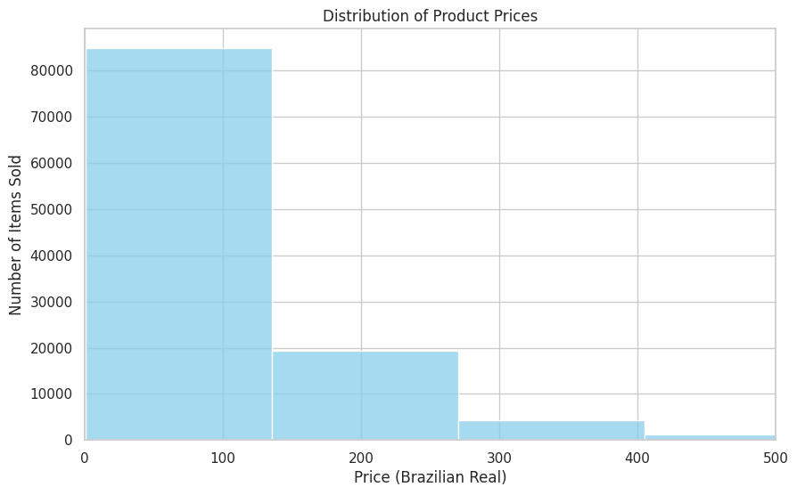
Numerical Profiling: Pricing
Right-Skewed Distribution
When analyzing the `price` column using a seaborn histogram (capped at 500 BRL to filter extreme outliers up to 6,735 BRL), we observe a distinct right-skewed distribution.
The core insight: The vast majority of Olist's product inventory and sales volume thrives in the low-to-mid ticket range, specifically clustering heavily between R$ 39.90 and R$ 134.90.

Slide 5
Step 2: SQL Business Intelligence
Extracting answers for multi-table business questions through advanced SQL Joins and Aggregations.

Slide 6
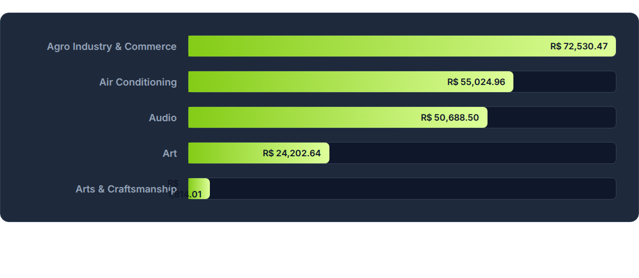
Query 1: Top Product Categories by Revenue
Output from joining `order_items`, `products`, and translation tables to sum total revenue generation per translated category.

Slide 7
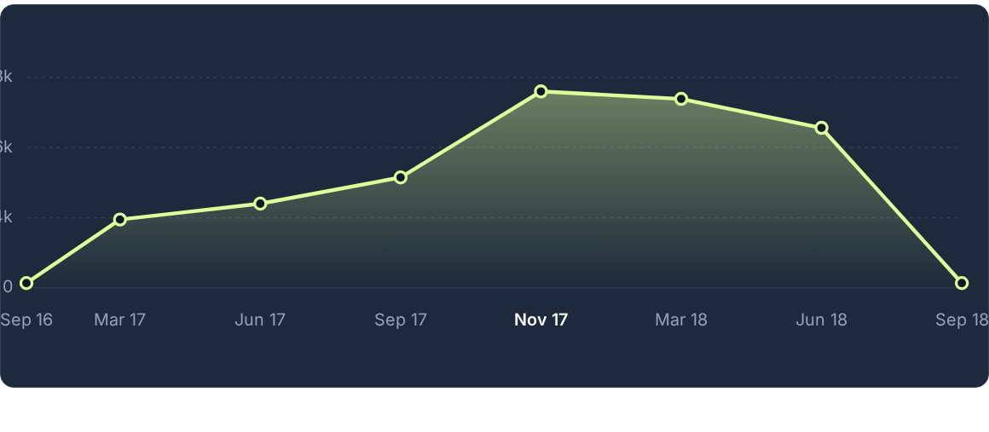
Queries 2 & 5: Monthly Order & Acquisition Trend
Orders and Initial Acquisitions scale perfectly together, peaking dramatically at 7,544 operations during November 2017.

Slide 8

Query 3: Customer City Revenue Sample
RANK / INDEX | CUSTOMER CITY | TOTAL REVENUE (R$)
1 | abaetetuba | 4,028.57
2 | abaete | 1,732.81
3 | abadiania | 949.99
4 | abadia dos dourados | 358.90
5 | abaiara | 262.90
Reflects the exact 5-record sample extracted during initial data sorting analysis.

Slide 9












Query 4: AOV by Distinct Payment Method
R$ 126.48
R$ 108.67
Credit Card Transactions
Debit Card Transactions
R$ 105.11
R$ 104.58
Voucher Purchases
Boleto Invoices

Slide 10


Query 6: Logistics Delivery Performance
7,827
8.11%
TOTAL LATE DELIVERIES
PERCENTAGE OF ALL DELIVERIES
Extracted by isolating records where the `order_delivered_customer_date` successfully bypassed the `order_estimated_delivery_date`.

Slide 11

Query 7: Quality Control (Highest 1-Star Reviews)
Product ID: 422879e10f46682990de24d770e7f83d — 79 Negative Reviews
Product ID: 53759a2ecddad2bb87a079a1f1519f73 — 65 Negative Reviews
Product ID: 368c6c730842d78016ad823897a372db — 65 Negative Reviews
Product ID: 99a4788cb24856965c36a24e339b6058 — 61 Negative Reviews
Product ID: e53e557d5a159f5aa2c5e995dfdf244b — 51 Negative Reviews
Direct SQL extraction isolating products with critical quality or description mismatch issues causing platform friction.

Slide 12
Step 3: Multivariate Analysis &
Correlation
Investigating how two or more numerical variables influence each other across combined datasets.

Slide 13
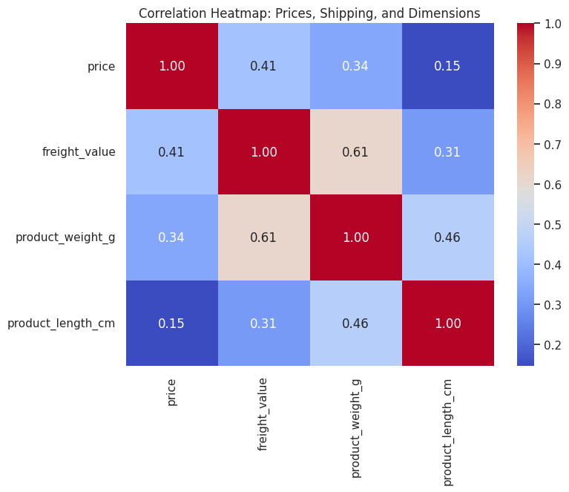

Numerical Correlation: Heatmap
•
Methodology: Merged `order_items` and `products` to analyze `price`, `freight_value`, `weight_g`, and `length_cm`.
•
Key Discovery: The strongest mathematical correlation exists between the physical characteristics of the item (specifically weight) and the resulting `freight_value` (shipping cost).
•
Lack of Price Influence: Interestingly, the base `price` of the product has virtually zero correlation with its dimensions, indicating varying value densities.

Slide 14
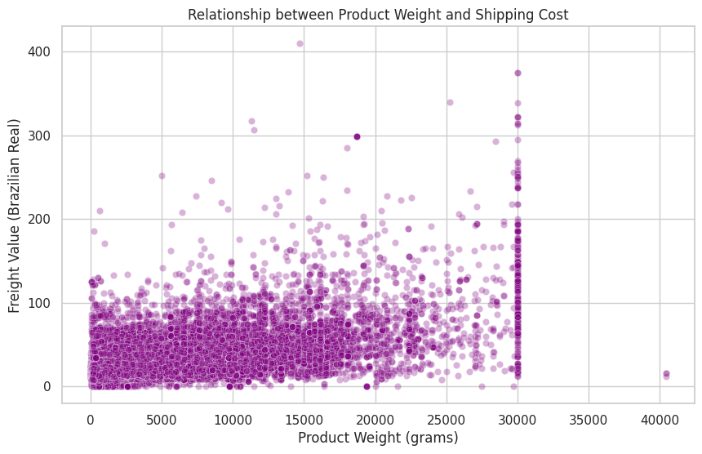
Multivariate Trend: Shipping Costs
Weight vs. Freight Value
To further investigate the heatmap findings, we plotted `product_weight_g` against `freight_value` via a Seaborn scatter plot (with alpha=0.3 to display density).
The visual confirms a strict positive linear relationship. As the physical weight of the product increases, the logistics pricing scales up predictably, providing a baseline formula for estimating future shipping ceilings.

Slide 15
THANK YOU!!!

